Slide 1



Presented by :
Anu vinaya.S-URK23EC3006
Multivariate Statistical Analysis and Interactive Visualization of Long-Term Gas Sensor Drift
Course Code: 23EC2001
Course Name: Introduction to Data Analytics
Institute: Karunya Institute of Technology and Sciences

Slide 2


01
Introduction
02
Problem Statement
03
Objective of the Project
04
Literature Survey
05
Dataset used
06
Proposed Methodology
07
Architecture Diagran
Agenda
08
Description of the Project
09
Results
10
Conclusion

Slide 3

Introduction
Gas sensor arrays are widely used in environmental monitoring, industrial safety, air quality assessment, and gas identification. However, sensor performance can change over time due to aging, environmental variations, contamination, and prolonged operation. This phenomenon, known as sensor drift, affects measurement accuracy, consistency, and the reliability of gas detection systems.
This project Statistical Characterization of Long-Term Gas Sensor Drift with an Interactive Analytics Dashboard analyzes measurements across multiple data batches using Python-based data analytics. It involves data preprocessing, quality assessment, descriptive statistics, and batch-wise comparisons to identify potential drift patterns and variations in sensor responses. An interactive Streamlit dashboard presents statistical summaries and visualizations, enabling users to explore sensor behavior and compare batches. The analysis provides a foundation for future sensor drift detection and compensation techniques.

Slide 4
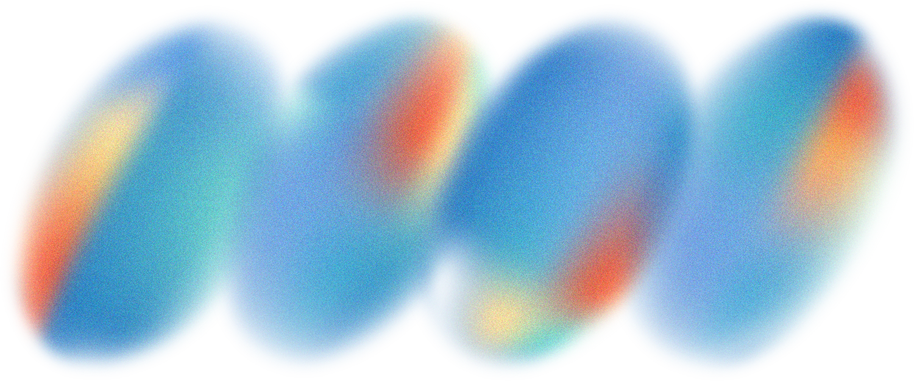
Problem Statement
PROBLEM 1: SENSOR DRIFT
PROBLEM 2: DATA ANALYSIS CHALLENGES
PROBLEM 3: LIMITED MONITORING & INTERPRETABILITY
Gas sensors experience gradual changes in sensitivity and baseline response over time due to ageing, environmental variations, and prolonged exposure to gases. This drift reduces measurement accuracy and affects the reliability of sensor readings.
Long-term sensor datasets contain variations across sensors, gas types, and measurement batches. Identifying drift patterns, detecting anomalies, and comparing sensor responses requires systematic statistical analysis and effective visualization techniques.
Conventional analysis often lacks an integrated interface for exploring sensor behaviour over time. An interactive web dashboard is needed to visualize drift trends, compare batches, examine statistical metrics, and support data-driven interpretation of sensor performance.

Slide 5

Objective of the Project
01
Sensor drift Characterization
02
Statistical Data Analysis
Analyze long-term gas sensor responses across multiple measurement batches to identify baseline variations, sensitivity changes, and temporal drift patterns.
Compute descriptive statistics and evaluate sensor response distributions to understand variations across gas types, sensor channels, and batches.
03
Anomaly Detection
04
Interactive Web dashboard
Identify unusual sensor readings and potential drift-related deviations using data quality checks, statistical analysis, and anomaly detection techniques.
Develop an interactive dashboard to visualize sensor trends, compare batch-wise performance, explore statistical metrics, and support effective interpretation of long-term sensor drift.

Slide 6
Literature Survey
Gas sensor arrays are widely used in environmental monitoring, industrial safety, and gas identification. However, sensor ageing, environmental changes, and prolonged gas exposure can cause sensor drift, reducing measurement accuracy over time.
Previous studies have explored statistical analysis, drift compensation, feature extraction, and machine learning techniques to characterize sensor response variations. Long-term gas sensor datasets, such as the Gas Sensor Array Drift Dataset, enable researchers to investigate drift patterns across different sensors, gas types, and measurement batches.
Despite these approaches, analyzing long-term drift requires effective comparison of sensor responses and clear visualization of statistical trends. This project addresses these needs through systematic data quality assessment, descriptive statistical analysis, drift pattern exploration, and an interactive web dashboard for visualizing sensor behaviour and comparing batch-wise variations.

Slide 7
Dataset used
Dataset Name: UCI Gas Sensor Array Drift Dataset
Source: UCI Machine Learning Repository
The dataset contains measurements collected from a gas sensor array over an extended period. It is used to study how sensor responses change over time, a phenomenon known as sensor drift.
The dataset contains:
  13,910 measurements collected using 16 chemical gas sensors.
  10 batches (batch1.dat to batch10.dat).
  6 different gases: Ammonia, Acetaldehyde, Acetone, Ethylene, Ethanol and Toluene.
  128 features representing sensor response characteristics.
  Data collected over approximately 36 months, making it useful for studying long-term sensor drift.

Slide 8
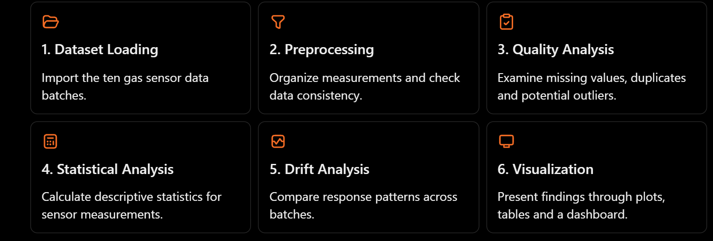
Proposed Methodology
Tools and technologies: Python, NumPy, Pandas, SciPy, Matplotlib, Seaborn, Statsmodels and Streamlit where used in your implementation.

Slide 9
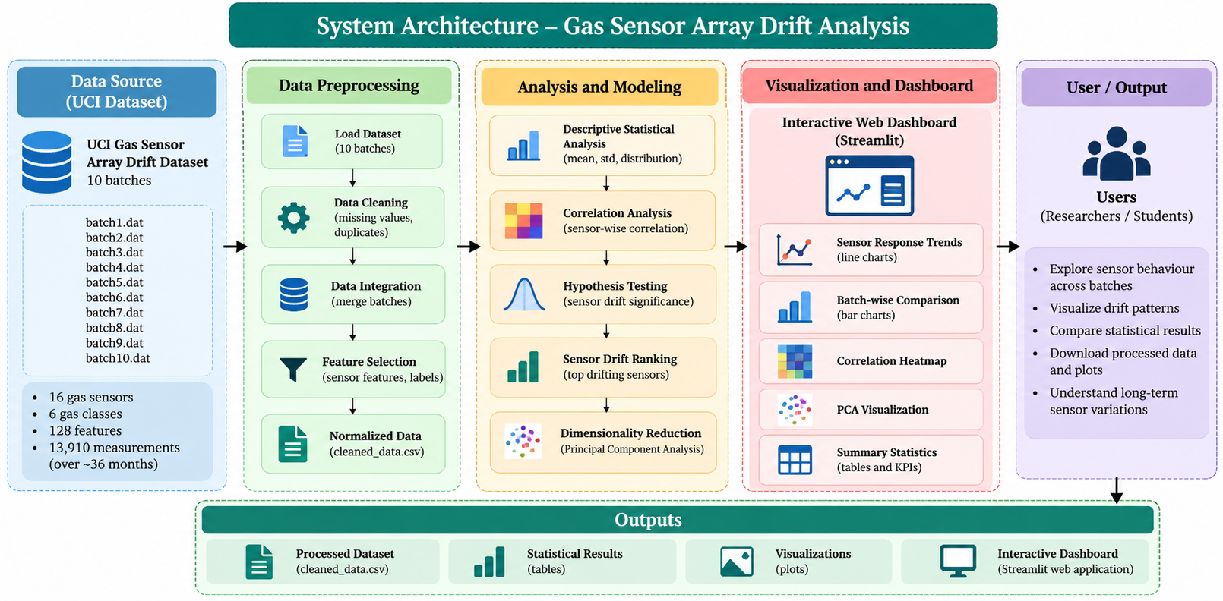
Architecture diagram

Slide 10
Description of the Project
This project analyzes long-term gas sensor drift using the UCI Gas Sensor Array Drift Dataset. Python-based statistical techniques, including descriptive analysis, correlation analysis, hypothesis testing and PCA, are used to study changes in sensor responses across multiple batches. An interactive Streamlit dashboard presents the results through graphs, heatmaps and statistical summaries, helping users understand sensor behaviour and identify drift patterns over time.

Slide 11
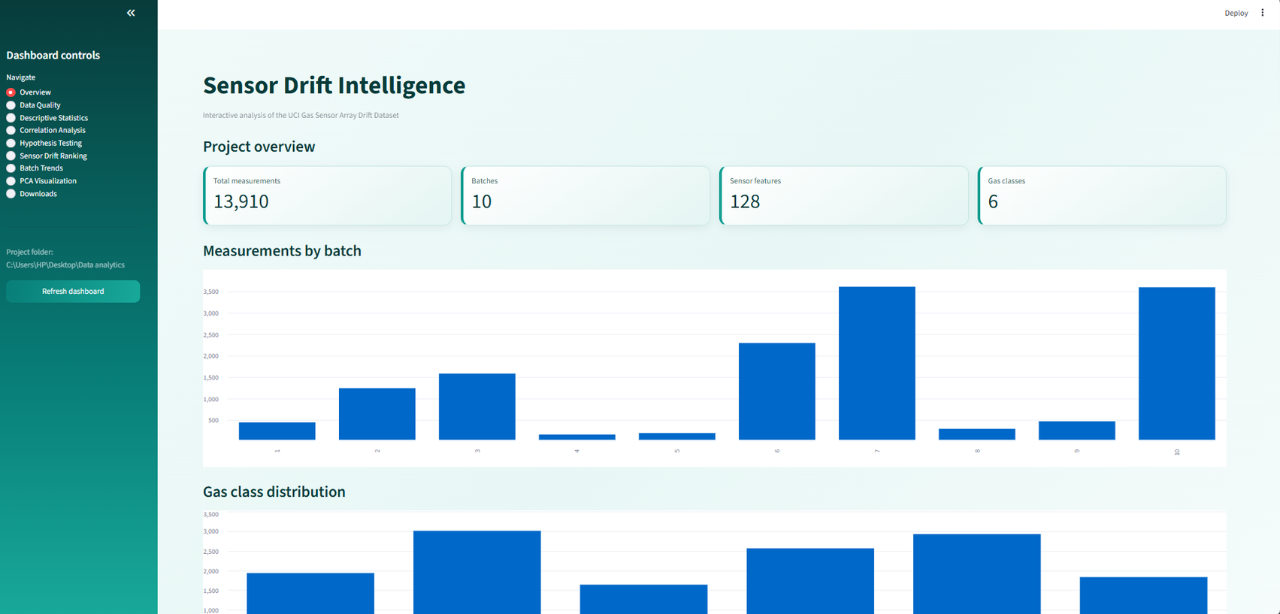
Result

Slide 12
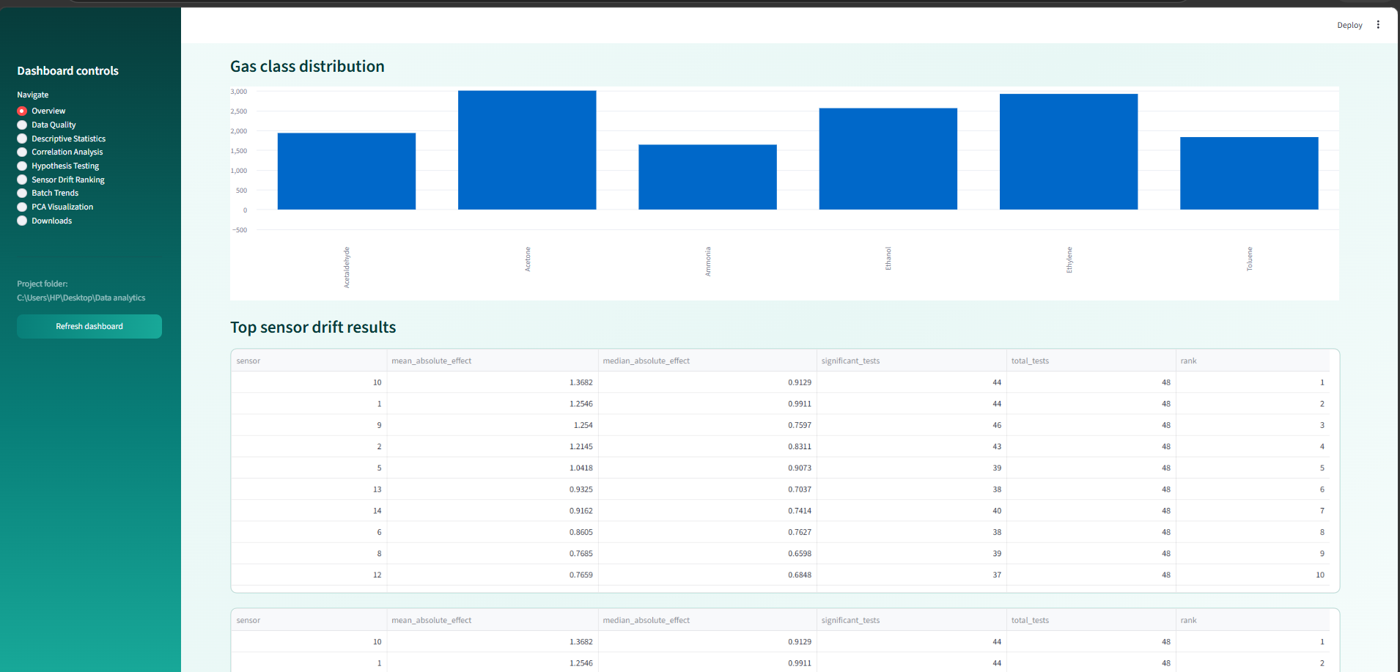

Slide 13
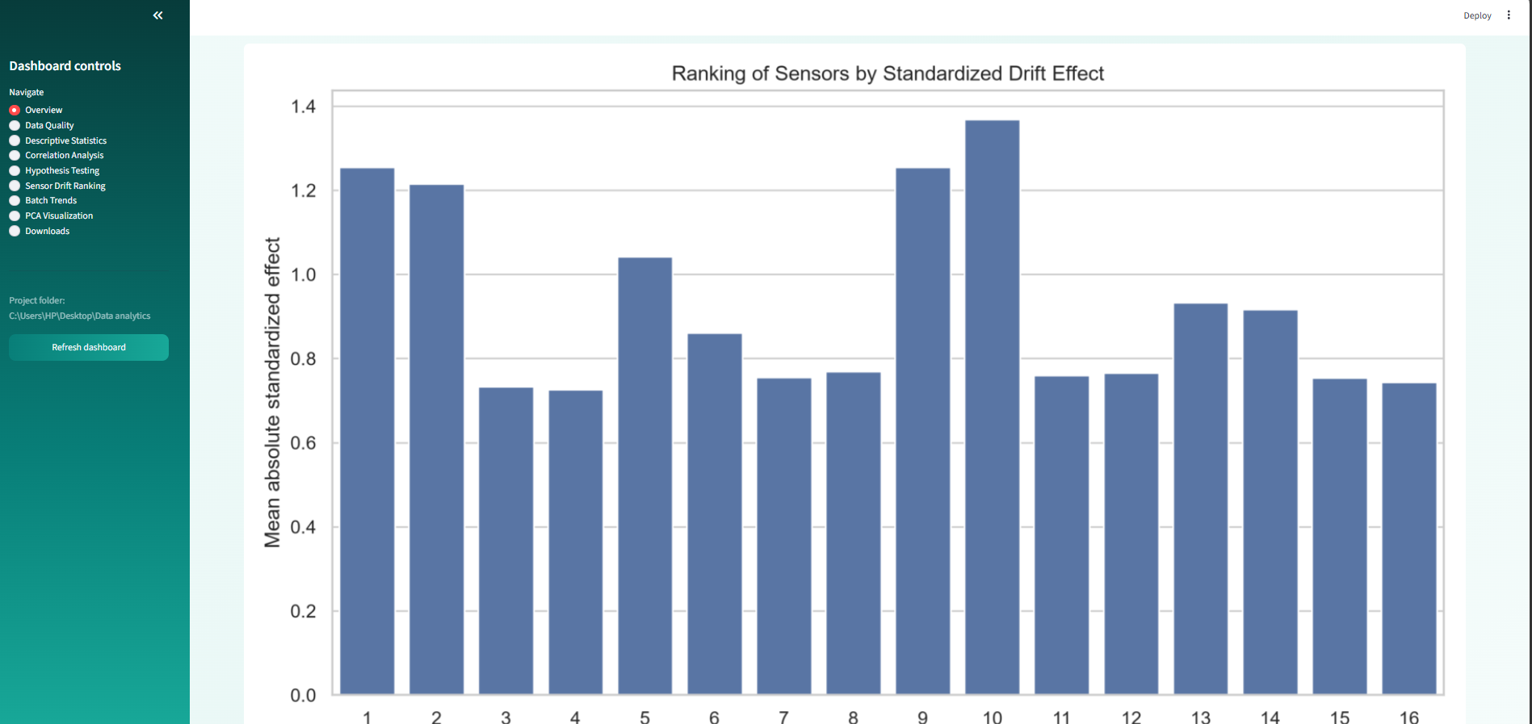

Slide 14
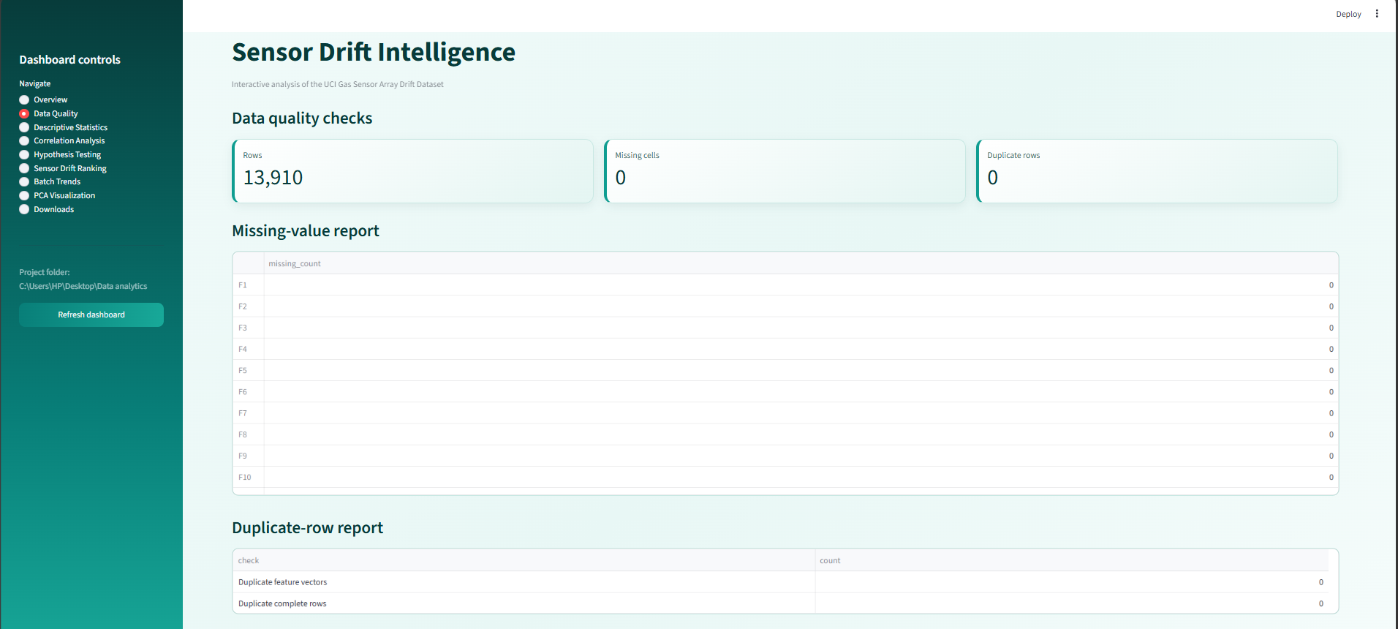

Slide 15
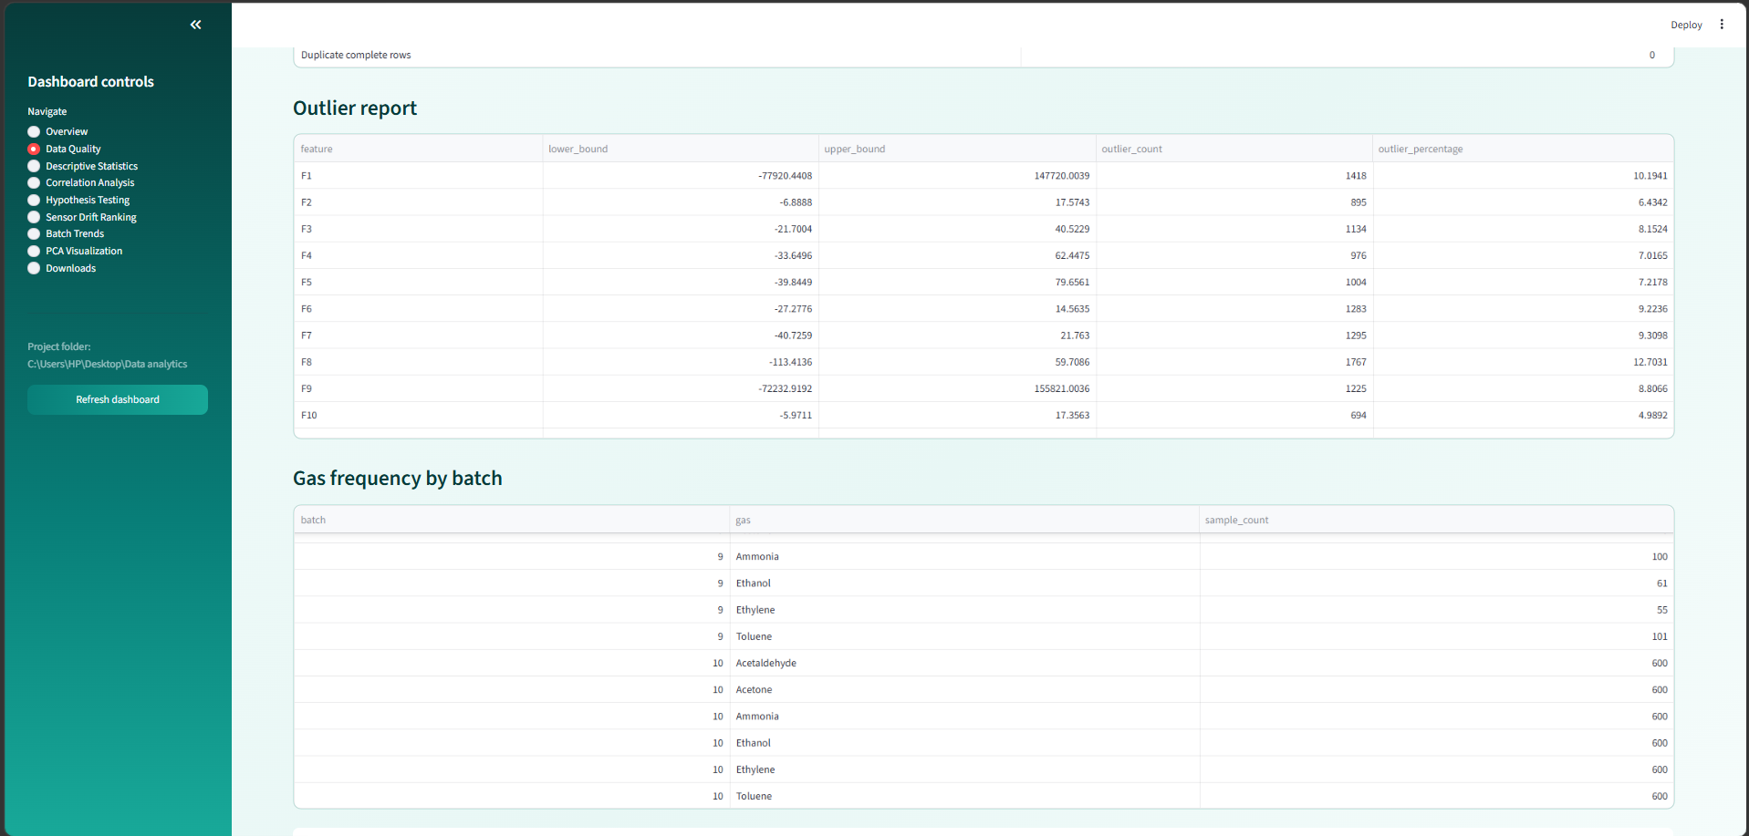

Slide 16
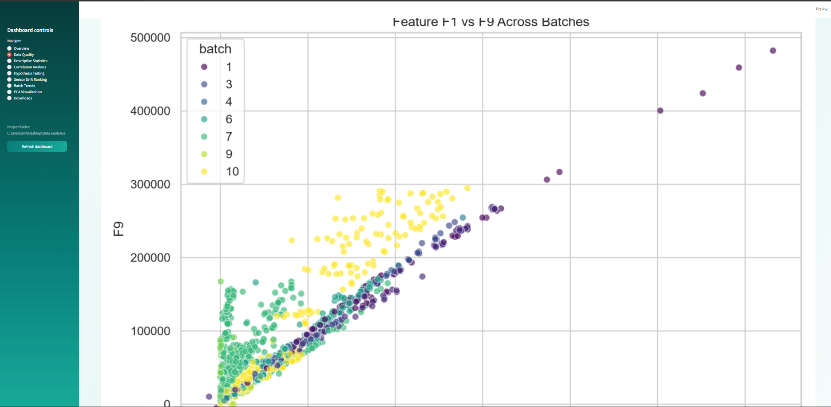

Slide 17
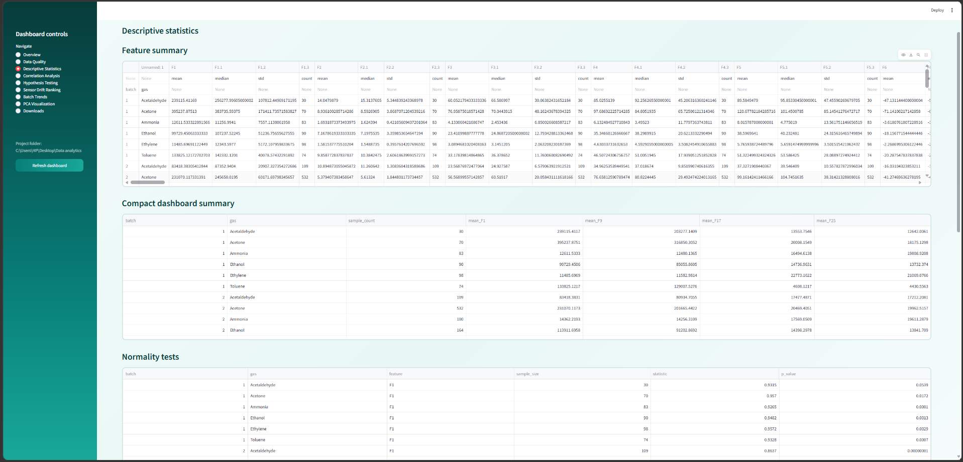

Slide 18
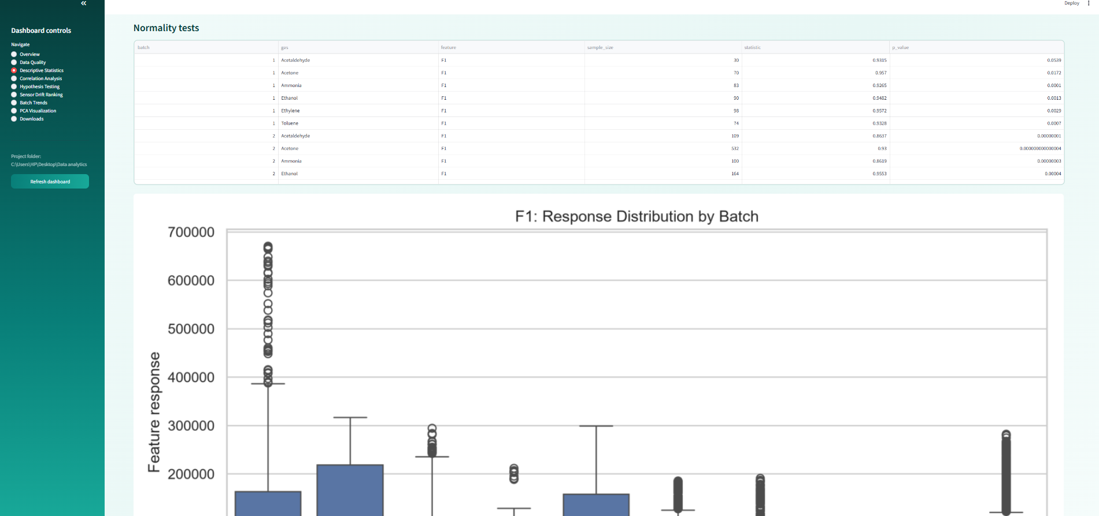

Slide 19
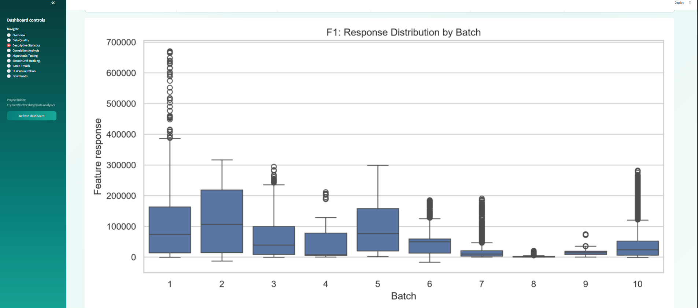

Slide 20
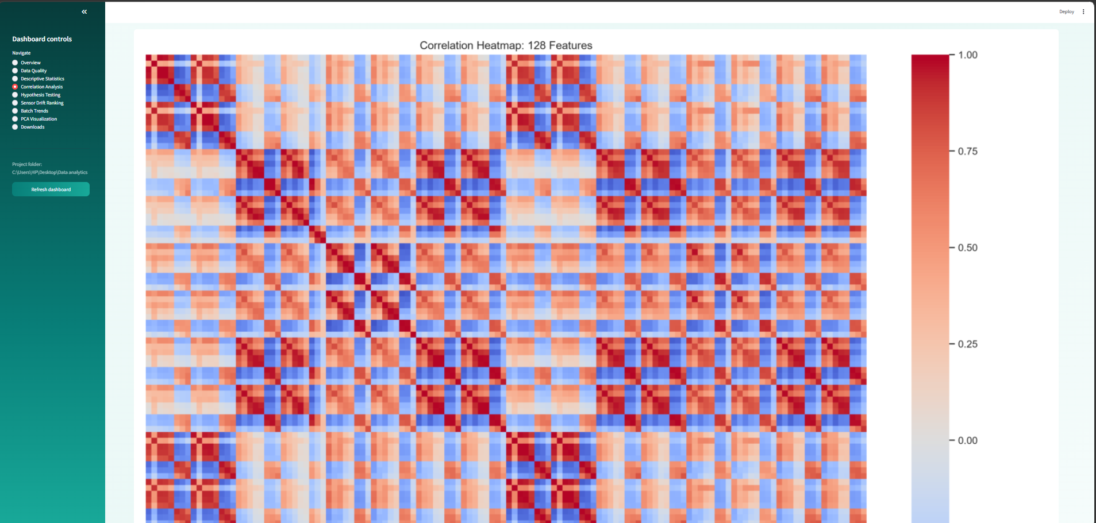

Slide 21
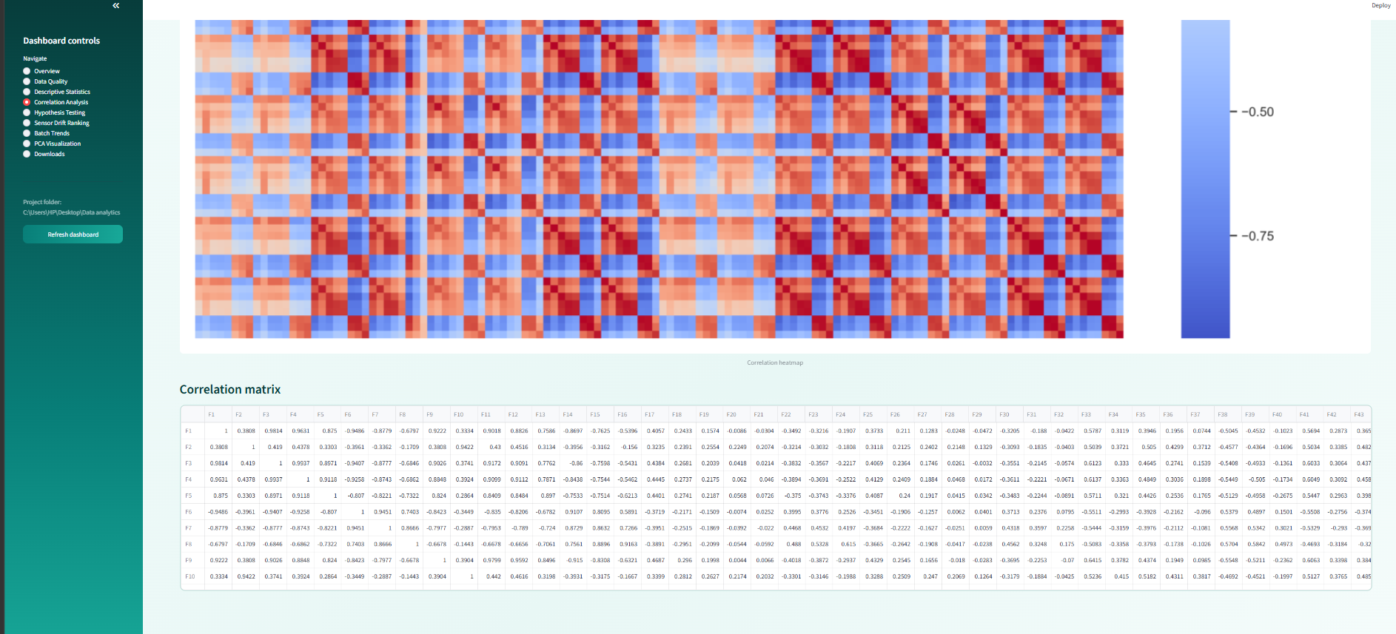

Slide 22
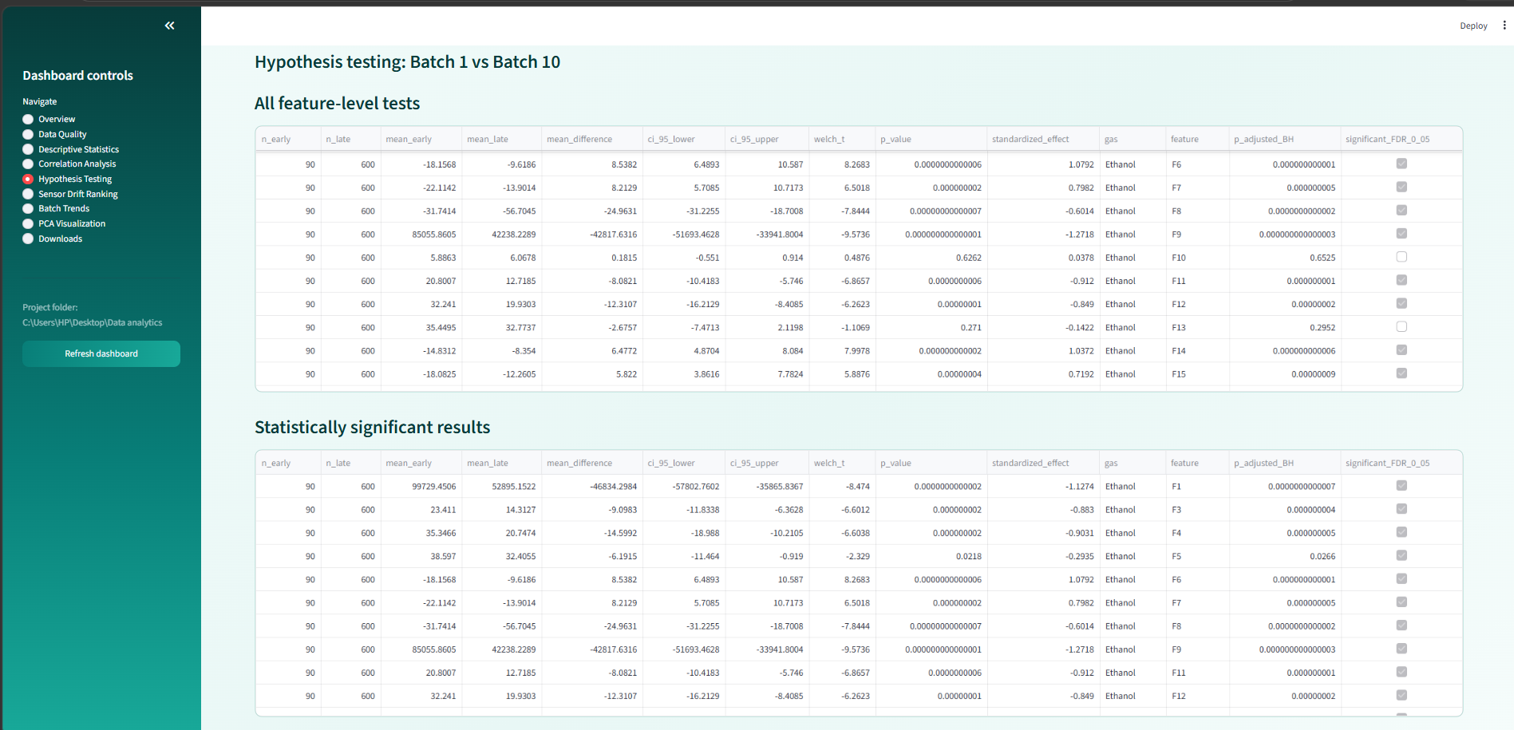

Slide 23
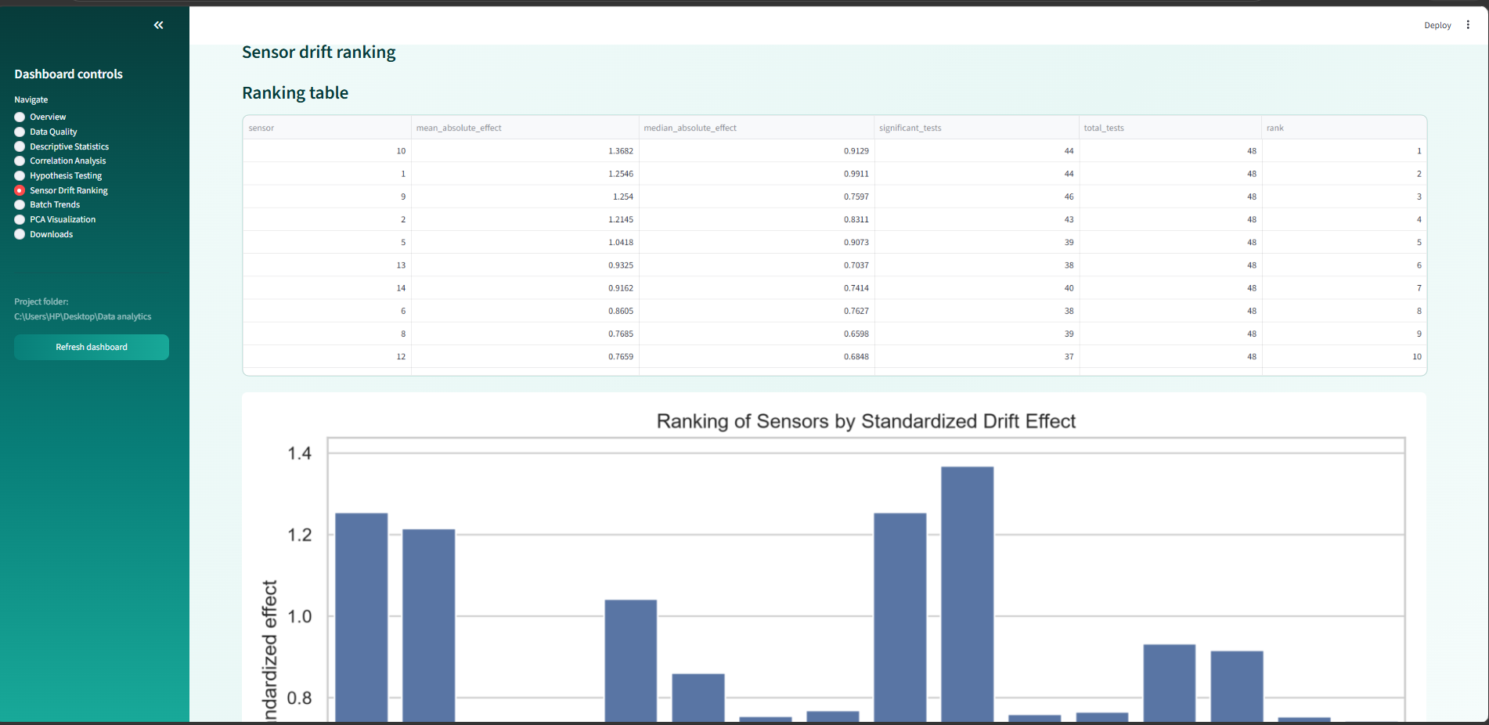

Slide 24
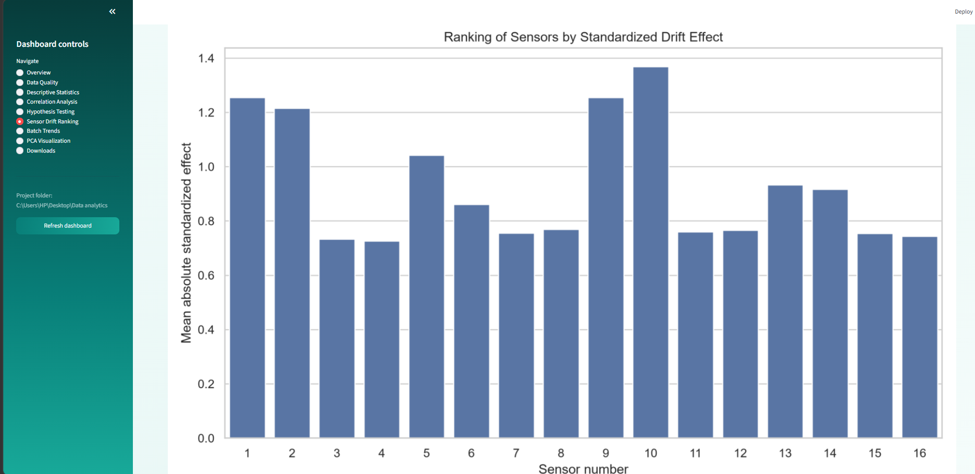

Slide 25
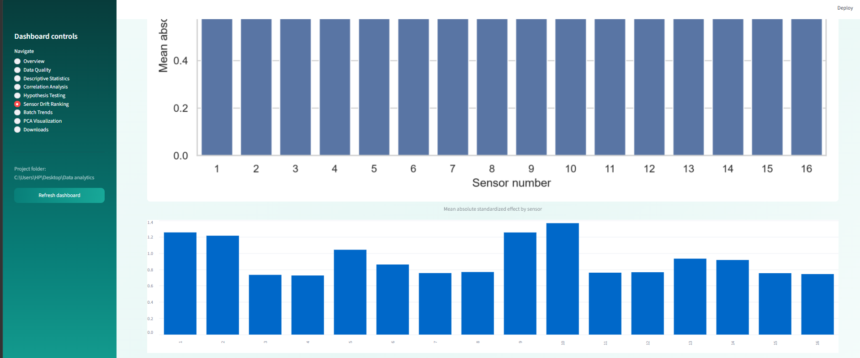

Slide 26
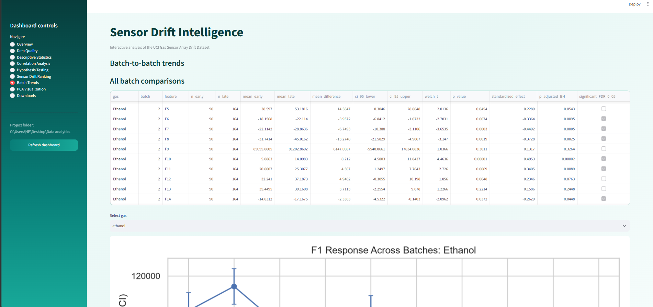

Slide 27
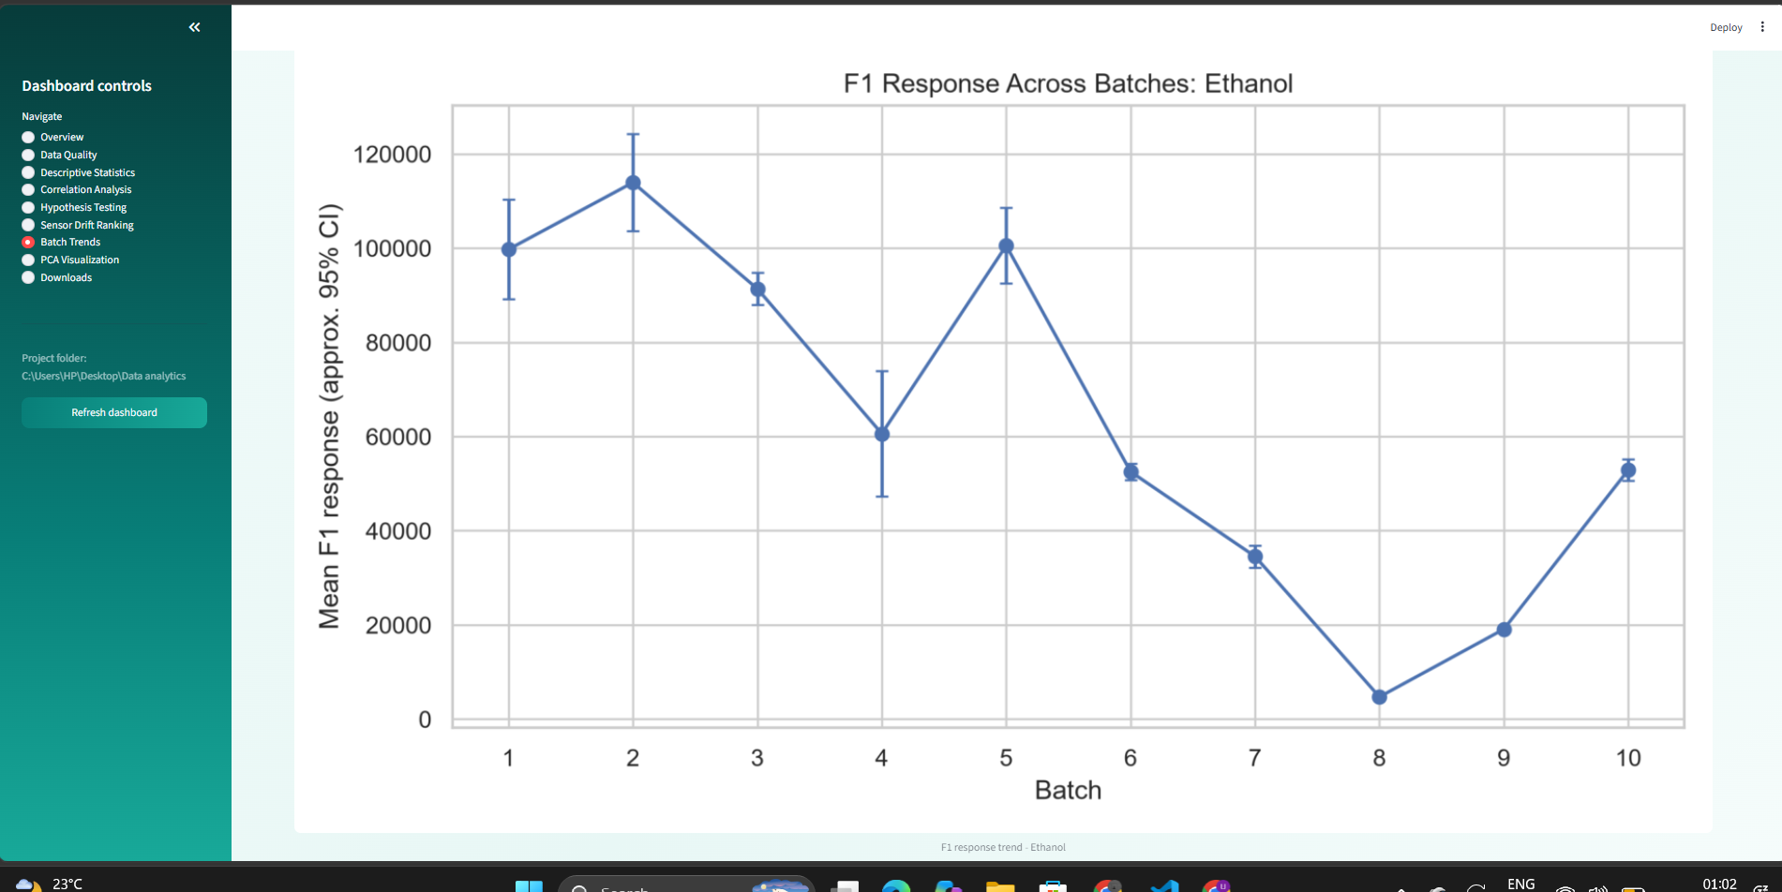

Slide 28
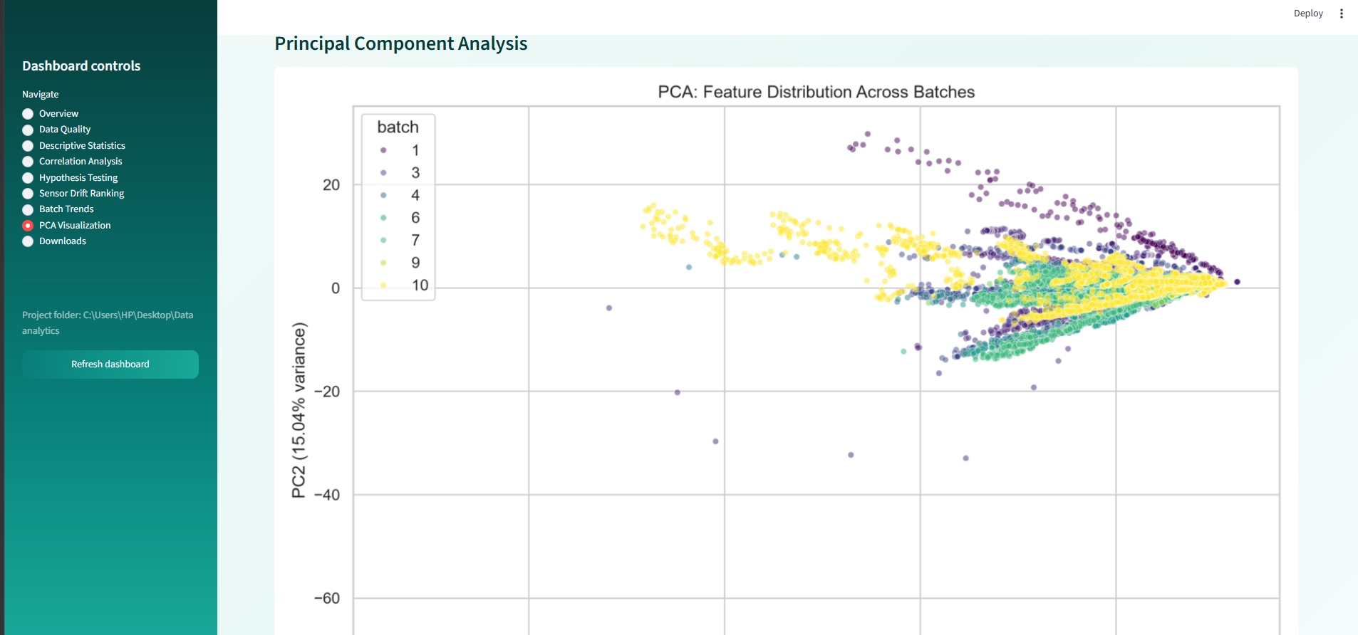

Slide 29
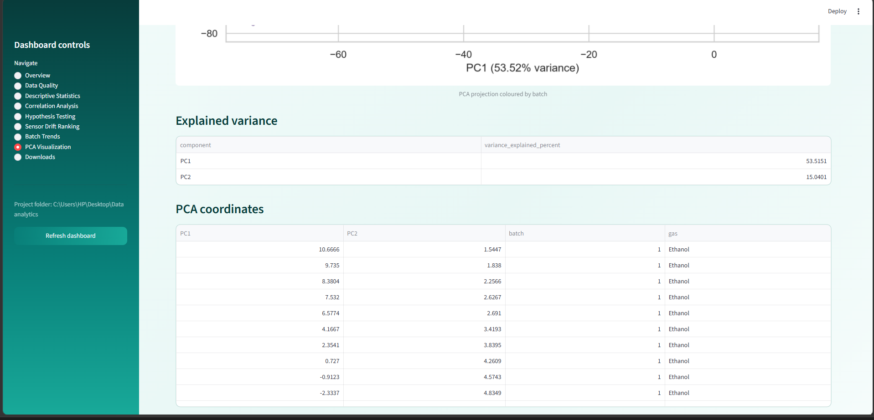

Slide 30
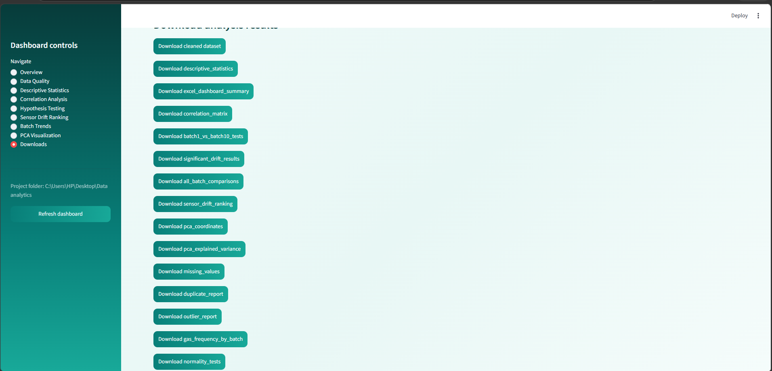

Slide 31
Conclusion
Future Scope
  This project provides a structured statistical analysis of long-term gas sensor measurements across multiple data batches.
  Data quality assessment helps identify missing values, duplicate records and potential outliers.
  Descriptive statistics and batch-wise comparisons help characterize variations in sensor responses.
  Visualizations make trends and distribution changes easier to interpret.
  The analysis can support further development of sensor drift detection, calibration strategies and reliable gas sensing systems.
  Implement quantitative drift metrics and statistical significance tests.
  Explore machine learning techniques for drift detection and compensation.
  Develop a real-time monitoring system for continuous sensor performance assessment.

Slide 32
Thank You

